Slide 1
Bake Buddy

Slide 2
Introduction
Bake Buddy is a software solution designed to streamline and automate bakery operations, including order processing, inventory management, sales tracking, and customer relationship management. The system enhances efficiency by reducing manual workload, minimizing errors, and improving overall productivity

Slide 3
Problem Statement
Manual order processing causes inefficiency.
Difficulty in tracking inventory and stock levels.
Lack of an integrated system for customers and bakery owners.

Slide 4
Technology Used
We used Java Spring-Boot as backend and React JS as Frontend in our Project.
Spring-Boot :–
The main goal of the Spring Boot framework is to reduce overall development time and increase efficiency. React has become the first choice for frontend because it gives developers the ability to work with a virtual browser (more friendly than the real browser). Also, a JavaScript developer can become a productive developer in a few hours because there is a small API to learn, a few functions, and how to use them…
React :–
React allows developers to create large web applications that can change data, without reloading the page. The main purpose of React is to be fast, scalable, and simple. Spring

Slide 5
OBJECTIVE
1. Efficient Order Management
2. Inventory Management
3. Sales and Billing Automation
4. Customer Relationship Management (CRM)

Slide 6
Customer Module
After successful registration, the customer can:
Search for available bakery
Edit their profile (update personal details, preferences, or contact information).
Delete their account (permanently remove their profile and data from the system).
Manage a booking cart

Slide 7
Admin Module
The Admin can:
View and manage user details.
Manage bakery listings and delete bakeries if necessary.
Oversee customer accounts and delete them if required.

Slide 8
Use Case

Slide 9
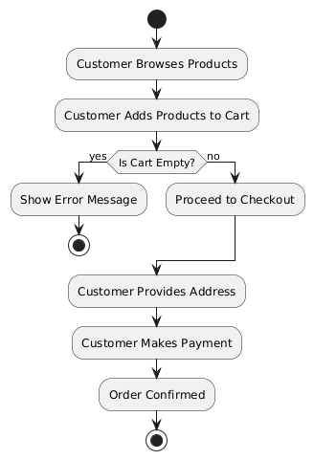
Activity Diagram

Slide 10
Future Enhancement
Mobile app version for ordering.
AI-based product recommendations.
Multi-branch bakery management.

Slide 11
Thank You

